Slide 1
Banking Management System
By:
Akashdeep Singh
Harleen Gulati
Mohammed Abdul Akram Khan
Mukhasir Shah Syed

Slide 2
Introduction
Describes basic operations for a bank system.
Basic functionalities:
Account creation
Deposit
Withdrawal
Loan
Complete package, A web application

Slide 3
Underlying Technologies
RDBMS MySQL
IDE MySQL workbench
Web Interface .net Framework

Slide 4
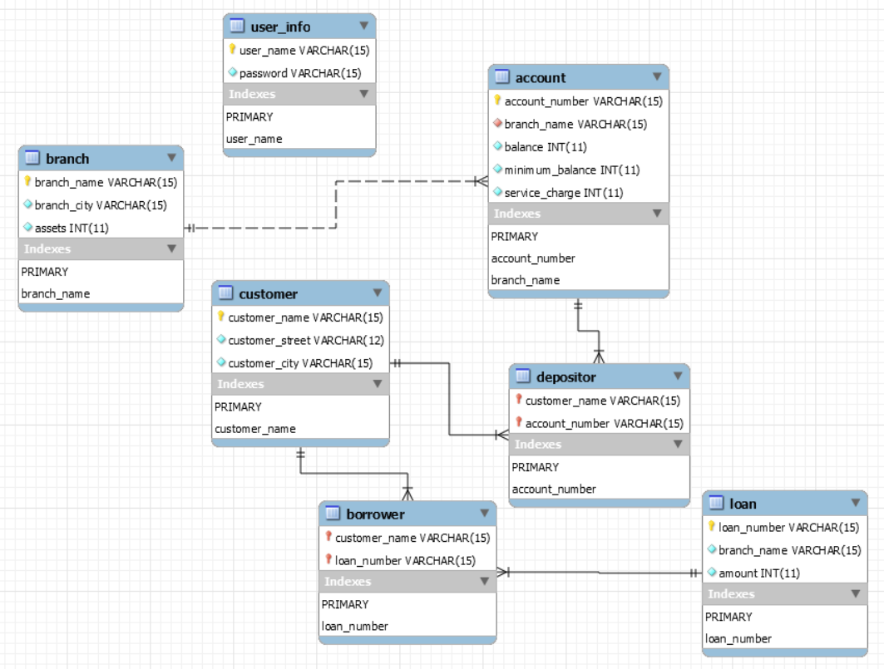
Database Outline
Involves 6 Tables:
Loan
Account
Branch
Borrower
Depositor
Customer
UserInfo

Slide 5
Implemented Functionalities
Concept of keys
Basic SQL queries
Aggregate functions
Views
Stored procedures
Data representation and analysis

Slide 6
SQL Demo
Basic querry Examples:
All account whose balance is smaller than 500.
select account_name from account where balance < 500;
all name of customers whose city is in Brooklyn
select customer_name from customer where customer_city='Brooklyn';
all employees whose salary is greater than 1400 and working branch is not
‘Downtown’
select * from employee where salary>1400 and branch_name<>’Downtown’;

Slide 7
Aggregate functions and Views
Calculate the average salary of all employees and show the average salary as “avg_salary”
select avg(salary) as avg_salary from employee ;
Calculate the number of customer for each account
select account_number, count(distinct customer_name) from depositor group by account_number;
Show all account_number, branch_name and corresponding branch_city
select account_number, branch.branch_name, branch_city from account, branch
where account.branch_name=branch.branch_name;
Select sum(assets) ,branch_city from branch group by branch_city;
Create
VIEW my_report AS
select d.customer_name,branch_city, b.branch_name, a.account_number, balance, bb.loan_number, l.amount as 'loan amount' from branch b
left join account a
on b.branch_name = a.branch_name
left join depositor d
on a.account_number = d.account_number
left join borrower bb
on d.customer_name = bb.customer_name
left join loan l
on bb.loan_number = l.loan_number
order by d.customer_name;

Slide 8
Introduction to Web Interface
It is a web application
Developed using .net
Easy to use
Simple User Interface

Slide 9
Web-App Demo
Web Application
User Interface walkThrough
Connection with database

Slide 10
Data representation and Analysis
Tableau - Data visualization software
Easy to use and understand
Study trends and relationships
Tableau Demo

Slide 11
Thank you

